Slide 1
CoutureAl: Clothing Image Generator Using Stable Diffusion Pipeline
Team Details:
TEAM LEAD: Bhupathi Paramesh
K.Sai Pranav
G.Venu
B.Rajesh

Slide 2
Introduction
- What is Stable Diffusion?
- Importance of AI in image generation
- Overview of the implementation

Slide 3
Prerequisites
Python 3.x
Required Libraries:
diffusers (for Stable Diffusion)
torch (for GPU acceleration)
PIL (for image handling)
os (for file management)
google.colab (for Google Drive support in Colab)

Slide 4
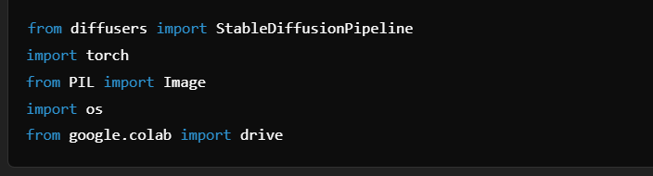
Importing Libraries

Slide 5
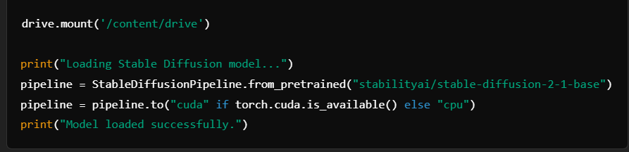
Loading the Model

Slide 6
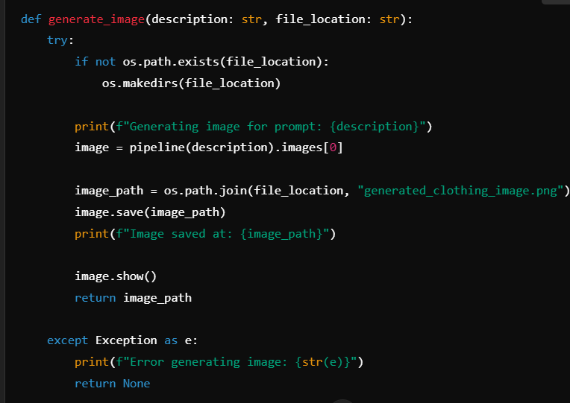
Defining the Image Generation Function

Slide 7
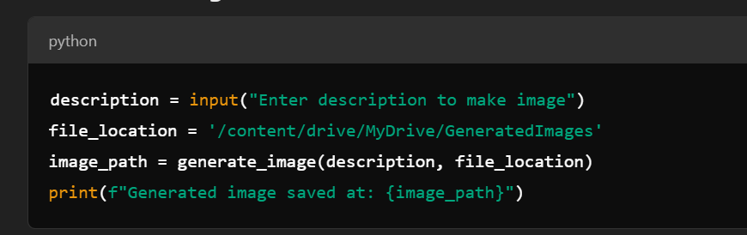
Running the Code

Slide 8
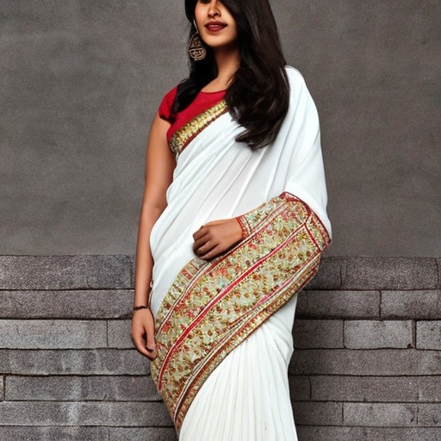
Output & Demonstration
Screenshot of generated images:-
Prompt :-“A white saree for fashion sale Display”

Slide 9
Conclusion & Future Enhancements
Benefits of AI-driven image generation:-
Possible improvements (e.g., fine-tuning, higher resolution, different models)
Integration with web applications
Rapid designing
Personal fashion
Cost efficiency
Enhancing creativity
Trend setting images

